Slide 1
Nesneye Dayalı Programlama
Sakarya Üniversitesi
Bilgisayar ve Bilişim Bilimleri Fakültesi
Bilgisayar Mühendisliği
Prof. Dr. Ümit Kocabıçak
Prof. Dr. Cemil Öz
13. HAFTA

Slide 2
Delegates
Delegate is a type which holds the method(s) reference in an object. It is also referred to as a type safe function pointer.
Declaring the Delegate Type
Delegates are types, just as classes are types. And as with classes, a delegate type must be declared before you can use it to create variables and objects of the type. The following example code declares a delegate type.
• The delegate type declaration, as with all type declarations, does not need to be declared inside a class.

Slide 3
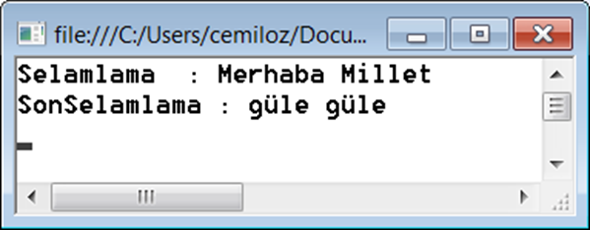
using System;
using System.Collections.Generic;
using System.Linq;
using System.Text;
namespace delege
{
public delegate void fonkdelegate(string mesaj);
class Program
{
static void Main(string[] args)
{
fonkdelegate del = new fonkdelegate(Selamlama);
del("Merhaba Millet");
del = new fonkdelegate(SonSelamlama);
del("güle güle");
}
public static void Selamlama(string selam)
{
Console.WriteLine(selam);
Console.Read();
}
public static void SonSelamlama(string selam)
{
Console.WriteLine(selam);
Console.Read();
}
}
}

Slide 4
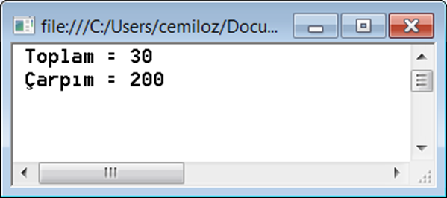
using System;
using System.Collections.Generic;
using System.Linq;
using System.Text;
namespace delege
{
public delegate int DortIslem(int a, int b);
class Program
{
static void Main(string[] args)
{
int sonuc;
DortIslem Islem = new DortIslem(toplama);
sonuc=Islem(10,20);
Console.WriteLine(" Toplam = " + sonuc);
Islem= new DortIslem(carpma);
sonuc = Islem(10, 20);
Console.WriteLine(" Çarpım = " + sonuc);
Console.Read();
}
public static int toplama(int a,int b)
{
return a + b;
}
public static int carpma(int a, int b)
{
return a*b;
}
}
}

Slide 5
using System;
namespace delegeatesOrnek2
{
class DortIslem
{
public delegate int FonkIsaret(int a, int b);
public FonkIsaret pointoOku(int index)
{
FonkIsaret nesneisaretcisi = null;
if (index == 1)
nesneisaretcisi = Topla;
else if (index == 2)
nesneisaretcisi = Cikarma;
else if (index == 3)
nesneisaretcisi = Carpma;
else if (index == 4)
nesneisaretcisi = Bolme;
return nesneisaretcisi;
}
public int Topla(int a, int b)
{
return a + b;
}
public int Cikarma(int a, int b)
{
return a - b;
}
public int Carpma(int a, int b)
{
return a * b;
}
public int Bolme(int a, int b)
{
if (b != 0)
return a / b;
else
return 0;
}
}
class Program
{
static void Main(string[] args)
{
DortIslem nesne1 = new DortIslem();
Console.WriteLine(" Toplama : " + nesne1.pointoOku(1).Invoke(10, 10));
Console.WriteLine(" Çıkarma : " + nesne1.pointoOku(2).Invoke(10, 10));
Console.WriteLine(" Çarpma : " + nesne1.pointoOku(3).Invoke(10, 10));
Console.WriteLine(" Bölme : " + nesne1.pointoOku(4).Invoke(10, 10));
Console.Read();
}
}
}

Slide 6
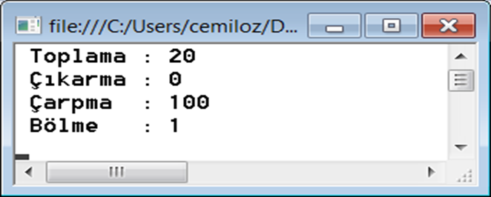

Slide 7
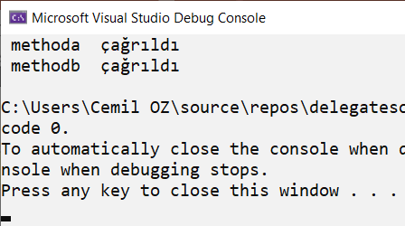
using System;
namespace delegatesornek
{
class A
{
public static string methoda(string s)
{
return " methoda " + s;
}
}
class B
{
public static string methodb(string s)
{
return " methodb " + s;
}
}
class Program
{
public delegate string MyDelegate(string s); // declare a delegate
static void Main(string[] args)
{
MyDelegate del = new MyDelegate(A.methoda);
// or
//MyDelegate del = a.methoda;
Console.WriteLine(del(" çağrıldı"));
del = B.methodb;
Console.WriteLine(del(" çağrıldı"));
}
}
}

Slide 8
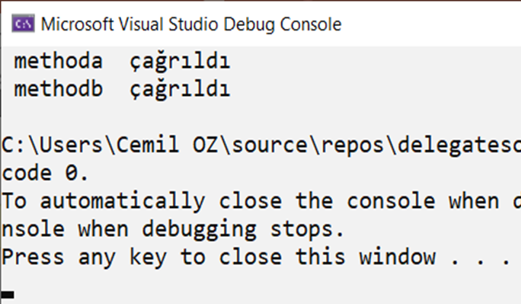
namespace delegatesornek
{
class A
{
public string methoda(string s)
{
return " methoda " + s;
}
}
class B
{
public string methodb(string s)
{
return " methodb " + s;
}
}
class Program
{
public delegate string MyDelegate(string s); // declare a delegate
static void Main(string[] args)
{
A a1 = new A();
B b1 = new B();
MyDelegate del = new MyDelegate(a1.methoda);
// or
//MyDelegate del = a1.methoda;
Console.WriteLine(del(" çağrıldı"));
del = b1.methodb;
Console.WriteLine(del(" çağrıldı"));
}
}
}

Slide 9
using System;
namespace delegeatesOrnek2
{
class A
{
public string methoda(string s)
{
return " methoda " + s;
}
}
class B
{
public string methodb(string s)
{
return " methodb " + s;
}
}
class Program
{
public delegate string MyDelegate(string s); // declare a delegate
static void Main(string[] args)
{
A a1 = new A();
B b1 = new B();
MyDelegate del1 = new MyDelegate(a1.methoda);
Console.WriteLine(del1(" çağrıldı"));
MyDelegate del2 = new MyDelegate(b1.methodb);
Console.WriteLine(del2(" çağrıldı"));
MyDelegate del = del1 + del2;
Console.WriteLine(del(" birleşim "));
del += del1;
Console.WriteLine(del(" birleşimler "));
}
}
}

Slide 10
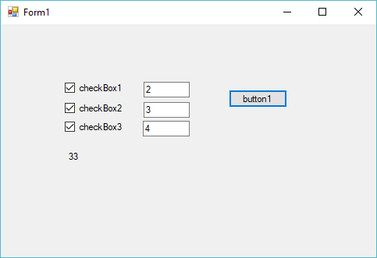
private void button1_Click(object sender, EventArgs e)
{
double tutar=0.0;
if (checkBox1.Checked)
tutar += double.Parse(textBox1.Text) * 2.0;
if (checkBox2.Checked)
tutar += double.Parse(textBox2.Text) * 3.0;
if (checkBox3.Checked)
tutar += double.Parse(textBox3.Text) * 5.0;
label1.Text = tutar.ToString();
}

Slide 11
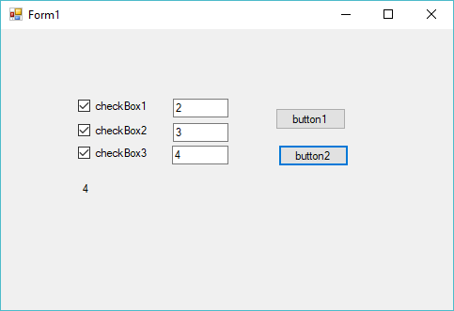
double tutar = 0.0;
if (checkBox1.Checked)
tutar += double.Parse(textBox1.Text) * 2.0;
else if (checkBox2.Checked)
tutar += double.Parse(textBox2.Text) * 3.0;
else if(checkBox3.Checked)
tutar += double.Parse(textBox3.Text) * 5.0;
label1.Text = tutar.ToString();

Slide 12
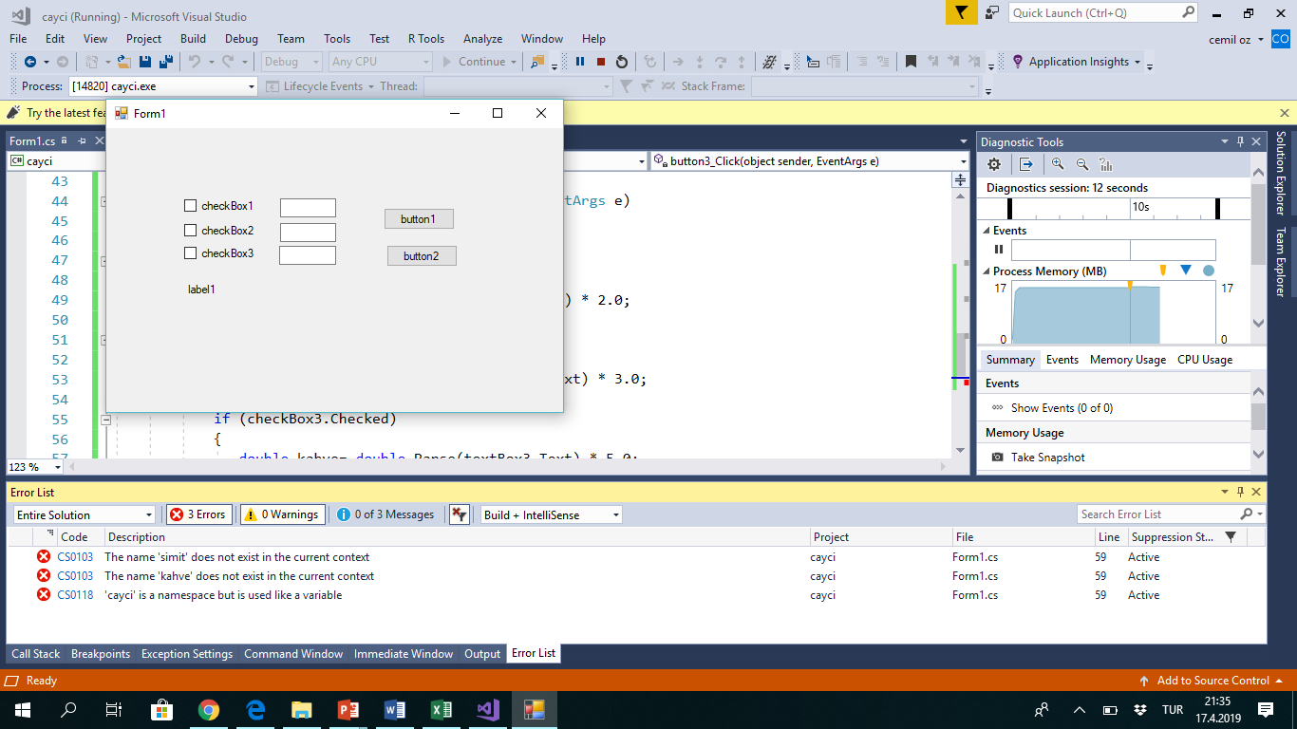
private void button3_Click(object sender, EventArgs e)
{
double tutar = 0.0;
if (checkBox1.Checked)
{
double cay= double.Parse(textBox1.Text) * 2.0;
}
if (checkBox2.Checked)
{
double simit= double.Parse(textBox2.Text) * 3.0;
}
if (checkBox3.Checked)
{
double kahve= double.Parse(textBox3.Text) * 5.0;
}
tutar = simit + kahve + cayci;
label1.Text = tutar.ToString();
}

